Slide 1
Sharktooth Software Restaurant App CSULB College of Engineering
CECS 491B Fall 2024 Instructor Iftikhar Shahnawaz
Alexandru Cioanca
Andrew Dutton
Dustin Phan
Gabriel Molina
Roberto Carvalho Brigagao
Thuan Nguyen

Slide 2
Introduction
Cloud-Hosted Database: The website's database is hosted in the cloud, ensuring reliability, scalability, and easy access.
Admin Portal Access: Restaurant administrators can easily access and manage the database through an intuitive admin portal.
Unique Features to Enhance User Experience:
Bill Splitting for Large Parties: Supports splitting the bill for up to 4 guests, making it convenient for larger groups.
Customizable Themes: A settings button allows users to customize the website's theme to align with the restaurant’s branding or personal preferences.
Local Order Printing: Seamlessly connects to a physical printer for printing order receipts locally, streamlining kitchen operations.
Scannable QR Codes: QR codes at tables allow customers to automatically load their table number, enabling a smoother ordering and billing process.

Slide 3
Who is our customer?
We recognize a growing trend among restaurants to provide greater convenience to their customers by enabling online ordering. This represents a significant and continually expanding market.
Despite the prevalence of digital solutions, many restaurants still rely on traditional physical menus, missing the opportunity to streamline their operations and enhance customer experience. By transitioning to a website-based system, restaurants can empower their customers to place orders directly without needing to interact with staff, saving time and reducing friction in the dining experience.
Our solution also caters to group dining by offering features like easy bill splitting, making it ideal for accommodating parties and enhancing customer satisfaction.
Notes:
Our target customers are restaurants that are looking to modernize and improve their operations by adopting online ordering systems.
We've noticed a growing trend where restaurants want to enhance convenience for their customers, and online ordering has become a key solution.
Despite this trend, many restaurants still depend on traditional physical menus, which limits their ability to streamline operations and provide a seamless customer experience.
By transitioning to a web-based POS system, restaurants can enable customers to order directly without staff intervention, saving time and creating a smoother experience for both parties.
Our system also addresses group dining challenges by offering features like easy bill splitting.
This is especially appealing for group settings, making it a convenient and satisfying experience for customers while reducing stress on restaurant staff.

Slide 4
Why our product?
Our website is easy to use and will reduce the wait time at a busy restaurant, removing the time where a server physically takes your order
This also allows people who might have been hired as a server to focus on other matters relating to running the restaurant, such as preparing food or cleaning.
With our app, a customer selects the items from the menu, and the order goes directly to the kitchen to prepare.
This increases restaurant through-put by reducing the time it takes for people making an order since all the information about the food is easily accessible on their phone.

Slide 5
How did we start?
Team members visited restaurants and looked their websites to see what we thought worked an didn't work, we then adapted our website based on that information.
Prepared our prototype
Worked on the system architecture and used an agile approach for development to build the product.
Through agile development we had many different iterations resulting in constant evolution of our product.
Notes:
To begin our project, we visited multiple restaurants and analyzed their websites to understand what worked well and what didn’t.
We used this research to shape the design and functionality of our own system.
Next, we prepared a prototype to test our ideas. From there, we developed the system architecture and adopted an agile development approach.
This allowed us to work in iterations, constantly improving our product based on feedback and testing.
Agile development was key to our success. Each iteration helped us refine our system, ensuring that it met the needs of both restaurant owners and their customers. By the end, our product had evolved into a robust and user-friendly POS solution

Slide 6
Where did we end?
We have a fully functional and easily expandable website that we host and use to provide support to local restaurants.
We plan to have an upfront cost to get the website and then charge for support.
We are easily able to manage a restaurants items through the admin portal linked to their website.
We managed to get all the unique features we planned
Splitting cart functionality
Different themes
QR codes for easy access
Notes:
Gabriel

Slide 7
What Did we Learn 1 – Cloud Deployment
Setup
The most important part of selecting a cloud solution is knowing how much memory and CPU you need; we used a benchmark for this.
Another important part of the setup is phase is selecting a cloud service that will support our webserver.
Deployment
We used continuous integration though Github to update the cloud service anytime someone pushed to our main branch.
We used Mongo Atlas to host our database on the cloud, providing easy scalability and efficient data management.
Challenges
We started using google cloud then moved to a different cloud solution because google cloud was very overkill for our product.
Notes:
Gabriel

Slide 8
What Did We Learn 2 – Team Collaboration
Working in a team comes with unique difficulties
Github
After spending all this time working as if we were a company, we learned to get things done efficiently.
Communication improved as the project came together
Ghantt chart / Trello management
Progress Reports are important!

Slide 9
What Did We Learn 3 – Adapting to Changes in the Project
Making changes to fit the customers' needs.
Working out reasonable backend and front-end design.
Changing the layout of the website to be more efficient and more beautiful.

Slide 10
Product Delivery / Installation
We would give the customer the choice to self-host or allow us to host it for them
The database could be either hosted on our end or by the customer using their own custom database solution.
Customer would give us a document of what they wanted on the website as well as an idea of what they wanted it to look like
After we got these documents we create their website, after they have confirmed they like the design we host it for them or remote into their server to setup the hosting for them locally

Slide 11
How is our website profitable?
We will have a low initial cost to setup the website based on the customers' needs
We will then charge for supporting the website
For example, if they found a bug they would call us, and we would remotely fix it for them
We will also have a model for charged based on resources needed and used by the customer
We will still allow the customer to self-host their website as we can be profitable from supporting the product for them
The focus of our income would be updates, support of the product, and sale of resources rather than selling the product itself

Slide 12
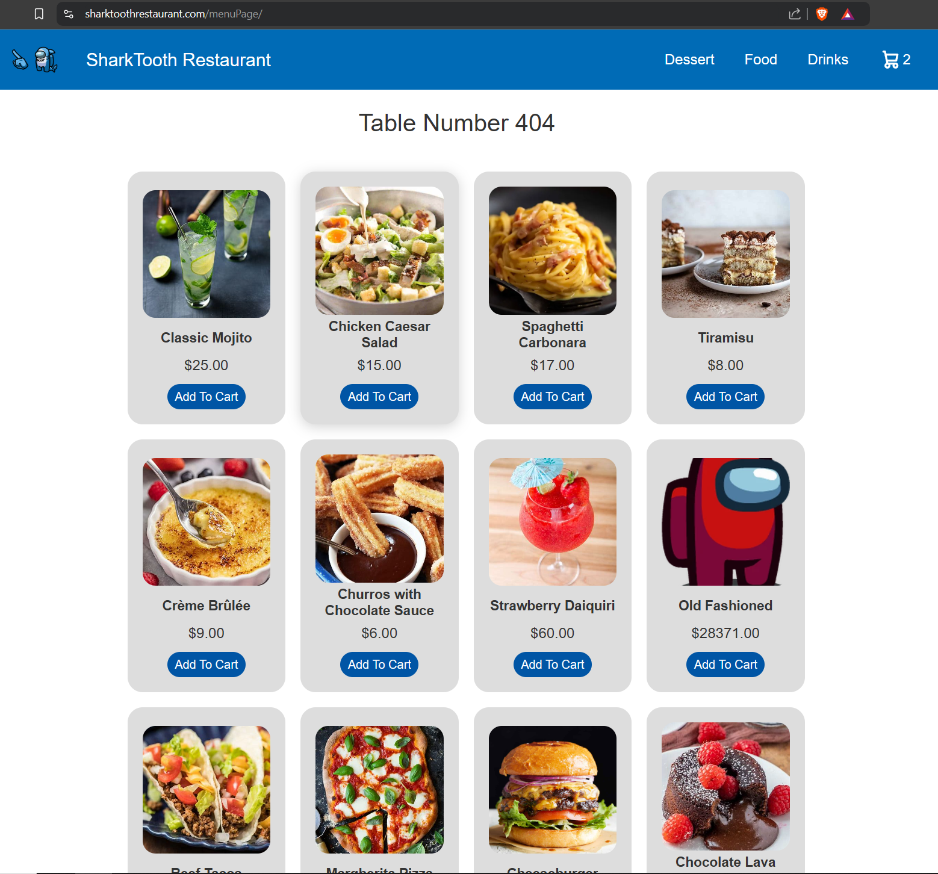
Welcome to the SharTooth Restaurant
www.sharktoothrestaurant.com

Slide 13
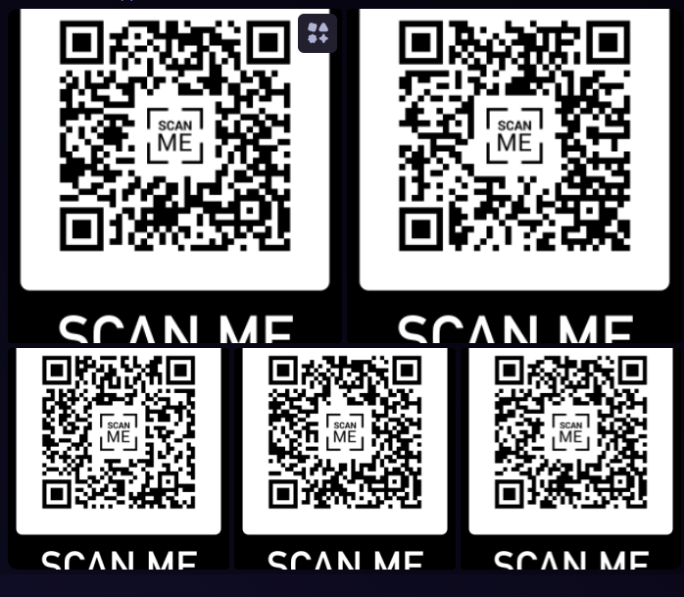

Slide 14

Thank you!

